Slide 1
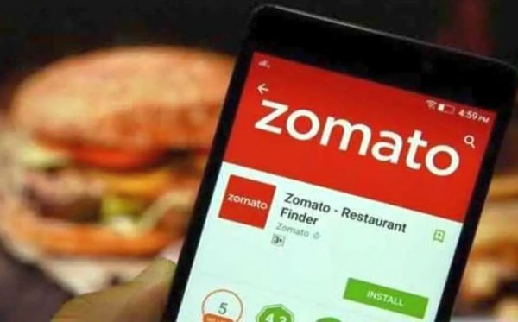

Zomato Data Analysis
By : mallesh h
BY: Ekta

Slide 2
ANALYSIS-OPENING NEW RESTAURANTS
Countries suitable for opening new restaurants with less competition
Cities suitable for opening new restaurants
Expenditure on food for the suggested countries
Restaurant ratings for the suggested countries
Competitor Analysis
Cuisines to be focused
Online delivery and table booking
Restaurants distributed based on price
Dash board

Slide 3




COUNTRIES
AUSTRALIA
CANADA
SINGAPORE
SRILANKA
Two factors considered in the selection of countries
Average rating : Choosing countries with lower ratings is advantageous for opening new restaurants, as it suggests a dissatisfaction among people with the existing restaurants in those regions.
Less number restaurants leads less competition

Slide 4
FEW CITIES IN SUGGESTED COUNTRIES
AUSTRALIA
CANADA
SINGAPORE
SRILANKA
Aramidale
Balingup
Flaxton
Macedon
Mayfield
Paynsville
Penola
Consort
Yorkton
Singapore
Colombo

Slide 5
Expenditure On Food
Country | Sum of Average_Cost_for_two_in_INR
Australia | 32281.3
Canada | 8992.9
Singapore | 194220.25
Sri Lanka | 12350

Slide 6
Average rating of restaurants in suggested countries
Country | Average of Rating
Australia | 3.658333333
Canada | 3.575
Singapore | 3.575
Sri Lanka | 3.87
The average rating in all the suggested countries is less than 4
By analysing we can confirm that the customers are dissatisfied with restaurants
Implementing innovative concepts, elevating service quality, and customizing offerings to align seamlessly with customer preferences, this proactive approach is designed to not only boost overall customer satisfaction but also secure a distinctive competitive advantage in the market.

Slide 7
Competitors Analysis
Restaurants with less competition
Star buffet
Pier 70
Poets cafe
Consort restaurant
Makansutra guttons bay
Indian elite Restaurant
Queens cafe
Restaurants with medium competition
Three Anchors
Bespoke Harvest
Divine
White bull Hotel
Tokyo sushi
Jaan
Calony
Artistry
Cafe shaze
CIOCONAT Lounge
The Paddington
Malay restaurant
Restaurants with high competition
Bridge road brewers
1918 Bistro & Grill
Vivo bar and Grill
Lake house restaurants
Al’frank cookies
Fratini la trattoria
The sizzle
Butter boutique
Cut by wolf gang puck
Simply strawberries by jagro

Slide 8

Cuisines with high Ratings
Cuisines
cuisines with high ratings among suggested countries
Pizza
Sea food
Mediterranean
Australian
Café
Bar food
American
Steak
Deserts
Modern Australian
The top rated cuisines Sea food, Italian, Pizza.

Slide 9
Online Delivery & Table Booking
Country | Table boooking | Online Delivery
Austarlia | 0 | 0
Canada | 0 | 0
Singapore | 0 | 0
Srilanka | 0 | 0
The recommended countries currently do not provide online delivery and table booking services
Upon entering the market, we can distinguish our brand by providing these services and incorporating a modest convenience fee.

Slide 10
Restaurants based on Price range
Row Labels | Count of RestaurantID
1 | 4444
2 | 3113
3 | 1408
4 | 586
There are 9551 number of restaurants in which
4444 number of restaurants in the range of 1
3113 number of restaurants in the range of 2
1408 number of restaurants in the range of 3
586 number of restaurants in the range of 4

Slide 11
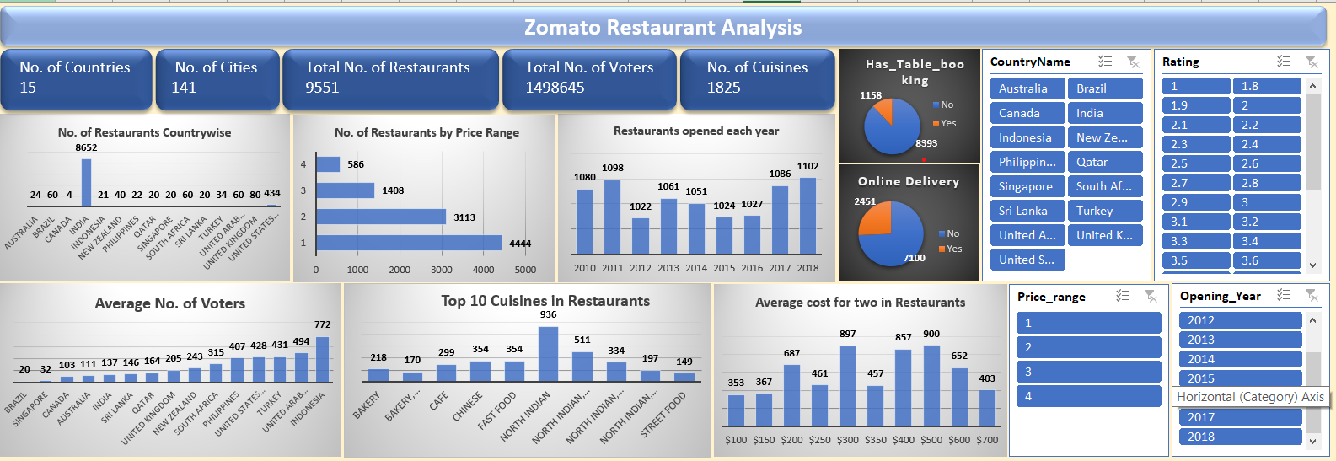
DASHBOARD

Slide 12
Thank
YOU

